Slide 1


Dhanujie Jayapala

Slide 2

Outline
Executive Summary
Introduction
Methodology
Results
Conclusion

Slide 3
Executive Summary
Summary of methodologies
In this exercise team used multiple methodologies to acquire and analyze the causal relationship of successful rocket landings by Space X.
Collect : Data collected using SpaceX REST API and web scraping techniques acquired data from Wikipedia
Wrangle : Convert raw data to create usable outcome variable
Explore : Data visualization techniques to explore trends, considering factors like payload, launch site, yearly trends.
Analyze : Analyzing the data with SQLlite
Geographic Mapping : Geographically visualize the launch site success rates and proximity to geographical locations using folium
Dashboard : An interactive dashboard website launch sites with the most success and successful payload ranges
Build Models : Machine Learning to predict landing outcomes using logistic regression, support vector machine (SVM), decision tree and K-nearest neighbor (KNN)

Slide 4
Executive Summary
Results can be Summarized into three buckets.
Exploratory Analysis
Success of missions has increase with time
We can observe a 100% success rate for ES-L1, GEO , HEO and SSO orbit types
There were serval drone ship landings
Visualization
Highest performing payload mass is between 2,000 and 6,000 kg
Space X has chosen sites near the equator. Other factors such as close to a main road and railway was also import
Being close to a coast makes some room for failed landings
Most successful site is KSC LC-39A with a success rate of 77
Predictive Analytics
Decision Tree Classifier has the best learning algorithm for the data available

Slide 5
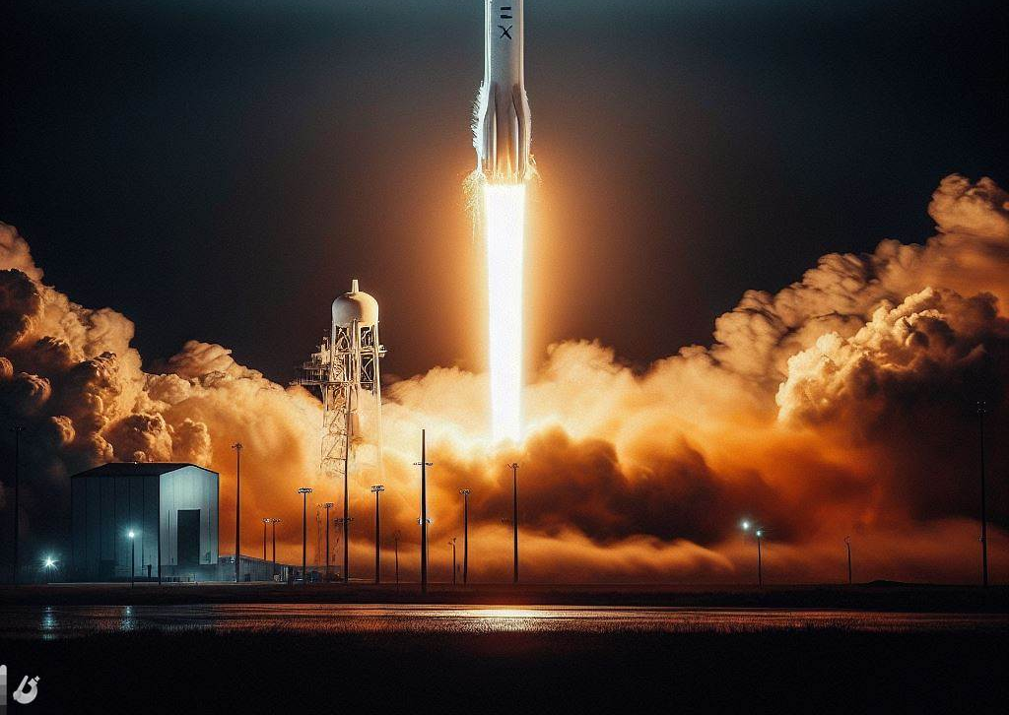
Introduction
SpaceX, officially known as Space Exploration Technologies Corp., is a revolutionary American aerospace company founded by Elon Musk in 2002.
Key Accomplishments:
Reusable Rockets: SpaceX has successfully developed and implemented reusable rockets like the Falcon 9 and Falcon Heavy, significantly reducing launch costs.
Human Spaceflight: SpaceX achieved the milestone of sending astronauts to the International Space Station (ISS) with its Dragon spacecraft, marking the first time a private company has transported humans to orbit.
Impact on the Space Industry:
Reduced Launch Costs: SpaceX's reusable rockets have dramatically lowered the cost of accessing space, opening up new possibilities for commercial and scientific endeavors.
Increased Innovation: The company's focus on innovation and pushing technological boundaries has spurred advancements in various areas of space technology.
Future Outlook:
SpaceX continues to drive the future of space exploration with its ambitious projects like Starship and Starlink. The company's innovative approach and commitment to reducing costs have positioned it as a major player in the global space industry, shaping the future of space travel and exploration.

Slide 6
Objectives of the Analysis
Understand key considerations for the success of Space X
Identify factors contributed to the success of the Space X program
Learn improvement patterns from the data available on Space X
Replicate the findings for better success for the in Strat up Space Y

Slide 7

Section 1

Slide 8
Methodology
Executive Summary
Data collection methodology:
Data were collecting mainly using two methodologies, which are web-scarping through Wikipedia and using SpaceX REST API platforms.
Perform data wrangling
Data preparation or wrangling was done by filtering the dataset, removing missing values and doing one hot encoding.
Perform exploratory data analysis (EDA) using visualization and SQL
Thr
Perform interactive visual analytics using Folium and Plotly Dash
Perform predictive analysis using classification models
How to build, tune, evaluate classification models

Slide 9
Data Collection
Identify the REST API supported URL
Call the GET request
Check if the status code is 200
Convert the JSON response by Pandas lib to a Dataframe
Filter from the Dataframe
Export Data to CSV
Drop or Filll NA values

Slide 10
Data Collection – SpaceX API
Key Code lines
# Requests allows us to make HTTP requests which we will use to get data from an API
import requests
# Pandas is a software library written for the Python programming language for data manipulation and analysis.
import pandas as pd
response = requests.get(spacex_url)
data = pd.json_normalize(response.json())
data.head()
Identify the REST API supported URL
Call the GET request
Check if the status code is 200
Convert the JSON response by Pandas lib to a Dataframe
Filter from the Dataframe
Export Data to CSV
Drop or Filll NA values
Name the columns
Import requests and Pandas libraries
Full Code Can be found in here:

Slide 11
Data Collection - Scraping
Key lines of Code
import requests
from bs4 import BeautifulSoup
import pandas as pd
html_data = requests.get(static_url)
html_data.status_code
soup = BeautifulSoup(html_data.text)
html_tables = soup.find_all('table’)
Identify the REST API supported URL
Call the GET request
Check if the status code is 200
Read html data using Beautiful Soup Obejct
Extract column names to a list
Write to dataframe for each row with FindAll tr and td
Add column names to a Dataframe
Find the table contents through FindAll(‘table’)
Import Beautifusoup4 and request libraries libraries
Full code can be found here

Slide 12
Data Wrangling
Key lines of Code
import pandas as pd
import numpy as np
df=pd.read_csv(csv_file_path)
df.isnull().sum()/len(df)*100
good_outcomes = set(landing_outcomes.keys()).difference(bad_outcomes)
landing_class = df['Outcome'].replace(good_outcomes, 1)
landing_class = pd.DataFrame(landing_class).replace(bad_outcomes, 0)
Load data from the CSV
Identify null values
Identify data types
Do one hot encoding for the selected objects ( Success vs Failure)
Import Pandas
Full code can be found here

Slide 13
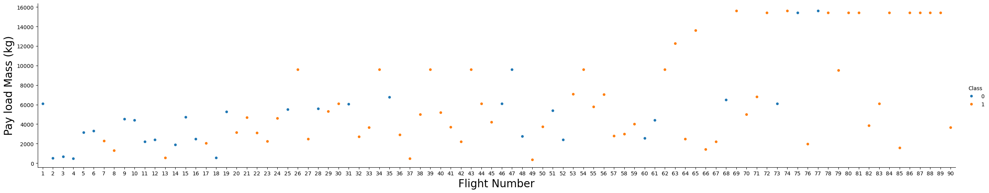
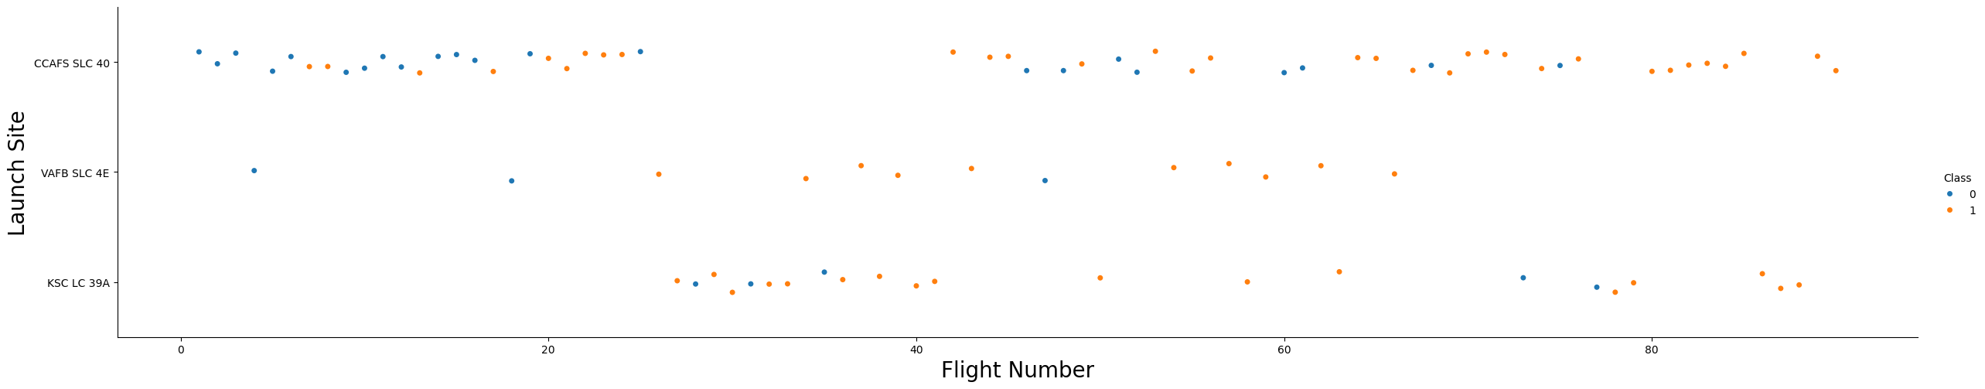
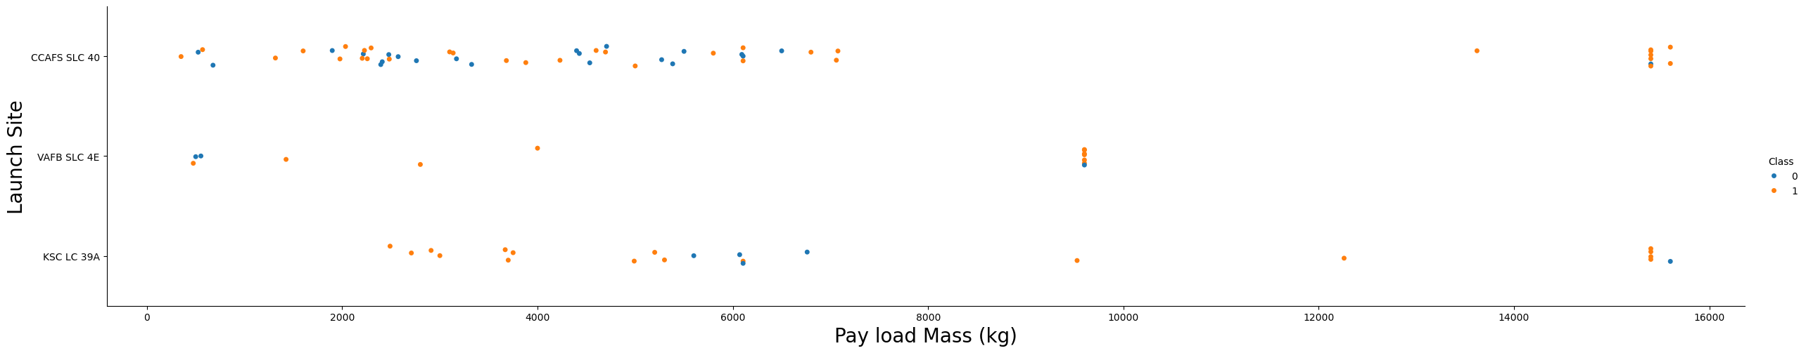
EDA with Data Visualization
Charts plotted and why
Flight Number vs Payload Mass with Success in Blue : To see how payload mass increased over time and success rate increased over time
Flight No vs Launch Site : What are more successful launch sites and what is used nowadays
Payload Mass vs Launch Site : To see if Launch site supports certain Payloads
Full workbook link :

Slide 14
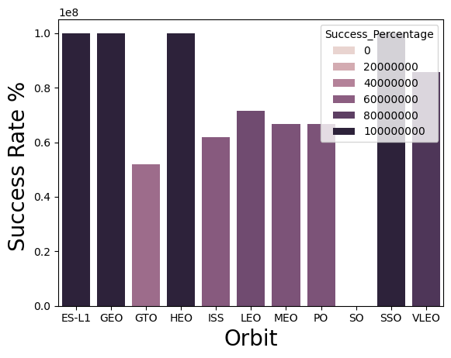
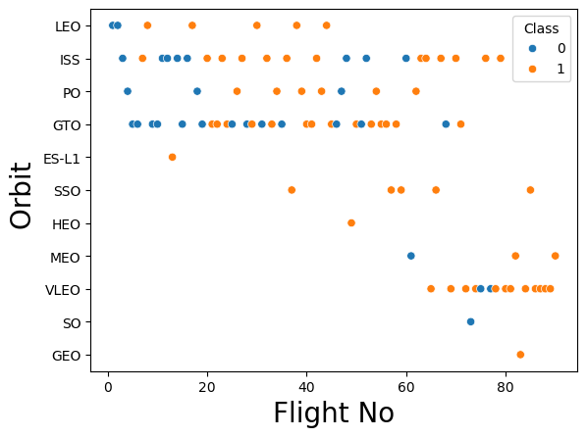
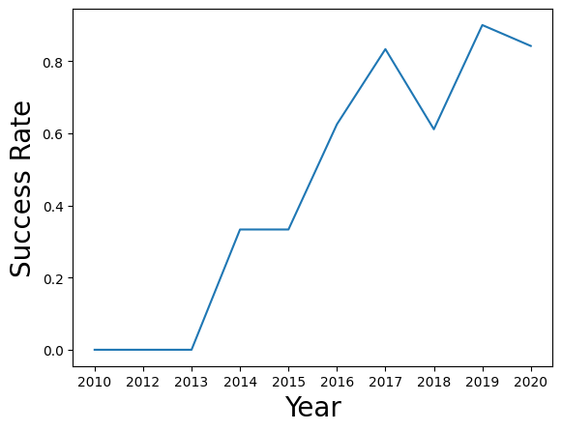
EDA with Data Visualization
Charts plotted and why
Orbit Type and Success Rates : To see any relations ship to see if there are any orbits that causes mission failures
Payload Mass vs Orbit Type : Any specific orbits types require a certain payload mass
Year vs Success Rate: How identify whether the success rate has improved over the years
Full workbook link :

Slide 15
EDA with SQL
Using bullet point format, summarize the SQL queries you performed
%sql create table SPACEXTABLE as select * from SPACEXTBL where Date is not null
%sql SELECT DISTINCT "Launch_Site" FROM SPACEXTBL
%sql SELECT * FROM SPACEXTBL WHERE "Launch_Site" LIKE "CCA%" LIMIT 5
%sql DESCRIBE SPACEXTBL
%sql SELECT AVG(PAYLOAD_MASS__KG_) FROM SPACEXTBL WHERE "Booster_Version" LIKE "F9 v1.1%"
sql SELECT MIN(DATE) FROM SPACEXTBL WHERE "Mission_Outcome" IS "Success"

Slide 16
EDA with SQL
Using bullet point format, summarize the SQL queries you performed
%sql SELECT DISTINCT "Booster_Version" FROM SPACEXTBL WHERE "PAYLOAD_MASS__KG_" BETWEEN 4000 AND 6000
%sql SELECT COUNT("Mission_Outcome") FROM SPACEXTBL WHERE "Mission_Outcome" IS "Success" OR "Success (payload status unclear)"
sql SELECT COUNT ("Mission_Outcome"),"Mission_Outcome" FROM SPACEXTBL GROUP BY "Mission_Outcome"
%sql SELECT DISTINCT "Booster_Version" FROM SPACEXTBL WHERE "PAYLOAD_MASS__KG_" IS ( SELECT MAX("PAYLOAD_MASS__KG_") FROM SPACEXTBL)
%sql SELECT substr("Date",6,2) as "Month" , substr("Date",0,5) as Year , "Landing_Outcome", "Booster_version", "Launch_site" FROM SPACEXTBL WHERE "Landing_Outcome" IS "Failure (drone ship)" AND SUBSTR("Date",0,5) IS "2015"
%sql SELECT "Mission_Outcome", COUNT("Mission_Outcome") as "Events" FROM SPACEXTBL WHERE "Date" BETWEEN "2010-06-04" AND "2017-03-20" GROUP BY "Mission_Outcome" ORDER BY "Events" DESC
Full code is here :

Slide 17
Build an Interactive Map with Folium
Summarize what map objects such as markers, circles, lines, etc. you created and added to a folium map
Explain why you added those objects
Add the GitHub URL of your completed interactive map with Folium map, as an external reference and peer-review purpose

Slide 18
Build a Dashboard with Plotly Dash
Summarize what plots/graphs and interactions you have added to a dashboard
Explain why you added those plots and interactions
Add the GitHub URL of your completed Plotly Dash lab, as an external reference and peer-review purpose

Slide 19
Predictive Analysis (Classification)
Summarize how you built, evaluated, improved, and found the best performing classification model
You need present your model development process using key phrases and flowchart
Add the GitHub URL of your completed predictive analysis lab, as an external reference and peer-review purpose

Slide 20

Section 2

Slide 21
Flight Number vs. Launch Site
Class 0 indicates failures and Class 1 indicates success.
We can observe that there is a higher failure rate in the first few years and the failure rate as reduced over the years.
Also, Initially the site they operated was mostly from CCAF5 5LC 40 and later moved to K5C LC 39A which has a higher success rate.

Slide 22
Payload vs. Launch Site
We can see the Falcon X team has done very high payloads ( ~ 15,000 kg) with a high success rate.
Most launches around 7000 kg were successful.
VAFB SL 4E site was not used for launches about 10,000 kg

Slide 23
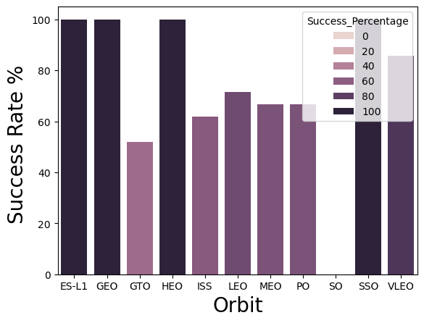
Success Rate vs. Orbit Type
We can observe a 100% success rate for ES-L1, GEO , HEO and SSO orbit types
SO has a 0% success rate.
GTO, ISS , MEO, PO, LEO and VLEO has an increasing success rates starting from 50% to 90% in consecutive order.

Slide 24
Flight Number vs. Orbit Type
Most initial launches are made from LEO, ISS, PO and GTO orbits.
For more recent flights they have preferred VLEO orbit.
The success rate has increased as the flight no increased, meaning the recent flights with higher success rate.

Slide 25
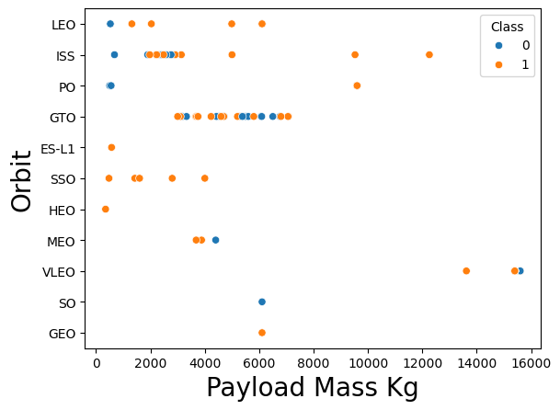
Payload vs. Orbit Type
Large payloads were sent to VLEO, ISS and PO orbits
GTO has been attempted with multiple medium level payloads, with mixed results.

Slide 26
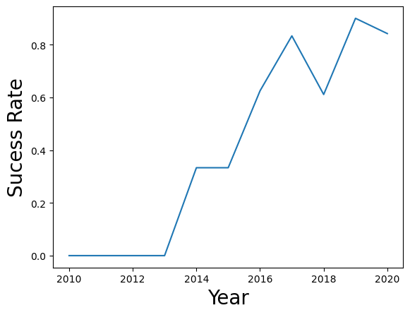
Launch Success Yearly Trend
There were no success for the first 4 years.
The success rate has improved over the years with an exception on year 2018 since 2013

Slide 27
All Launch Site Names
Unique launch site names are
CCAFS LC-40
VAFB SLC-4E
KSC LC-39A
CCAFS SLC-40
The SPACEXTBL has all the launches. Hence we need to find distinct names under “Launch Site” column to see the names of all sites.
Query to get the above result are as below.
%sql SELECT DISTINCT "Launch_Site" FROM SPACEXTBL

Slide 28
Launch Site Names Begin with 'CCA'
Records starting the launch site name as CCA are to the right.
We have selected five results from SPACEXTBL, then on Launch Site column , we have search for strings starting with CCA. % denotes trailing string with any character/s.
The code to get the above result is as follows.
%sql SELECT * FROM SPACEXTBL WHERE "Launch_Site" LIKE "CCA%" LIMIT 5
Date | Time (UTC) | Booster_Version | Launch_Site | Payload | PAYLOAD_MASS__KG_ | Orbit | Customer | Mission_Outcome | Landing_Outcome
2010-06-04 | 18:45:00 | F9 v1.0 B0003 | CCAFS LC-40 | Dragon Spacecraft Qualification Unit | 0 | LEO | SpaceX | Success | Failure (parachute)
2010-12-08 | 15:43:00 | F9 v1.0 B0004 | CCAFS LC-40 | Dragon demo flight C1, two CubeSats, barrel of Brouere cheese | 0 | LEO (ISS) | NASA (COTS) NRO | Success | Failure (parachute)
2012-05-22 | 7:44:00 | F9 v1.0 B0005 | CCAFS LC-40 | Dragon demo flight C2 | 525 | LEO (ISS) | NASA (COTS) | Success | No attempt
2012-10-08 | 0:35:00 | F9 v1.0 B0006 | CCAFS LC-40 | SpaceX CRS-1 | 500 | LEO (ISS) | NASA (CRS) | Success | No attempt
2013-03-01 | 15:10:00 | F9 v1.0 B0007 | CCAFS LC-40 | SpaceX CRS-2 | 677 | LEO (ISS) | NASA (CRS) | Success | No attempt

Slide 29
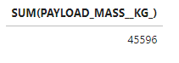
Total Payload Mass
Total Payload Mass for the customer NASA CRS missions are 45,596 kg
Here we are selecting a sub table of PAYLOAD_MASS_KG , from the SPACEXTBL , when the customer is NASA CRS and summing the result.
Code is as following
%sql SELECT SUM(PAYLOAD_MASS__KG_) FROM SPACEXTBL WHERE CUSTOMER IS 'NASA (CRS)’

Slide 30
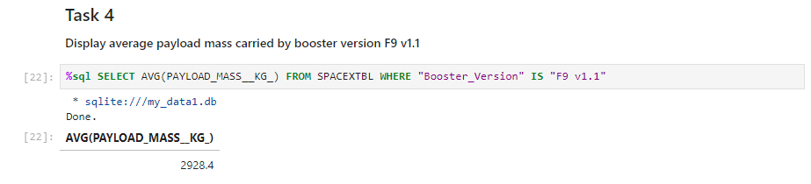
Average Payload Mass by F9 v1.1
The average payload mass by F9 v1.1 is 2928.4
Here we do a small table of SPACEXTBL where the Booster version is F9 v1.1 and getting the average of the results.
The SQL query goes as below.
%sql SELECT AVG(PAYLOAD_MASS__KG_) FROM SPACEXTBL WHERE "Booster_Version" IS "F9 v1.1"

Slide 31
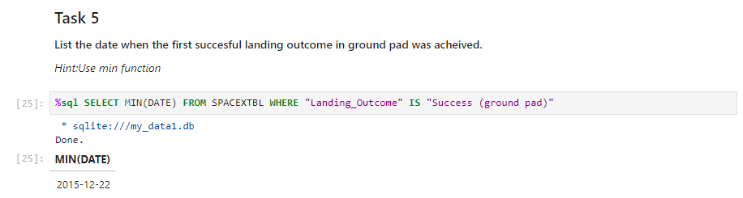
First Successful Ground Landing Date
First successful landing outcome on ground pad was on 22/12/2015
The query ran was
%sql SELECT MIN(DATE) FROM SPACEXTBL WHERE "Landing_Outcome" IS "Success (ground pad)"
Finding the earliest data (minimum) of which Landing outcome is “Success (ground pad”

Slide 32
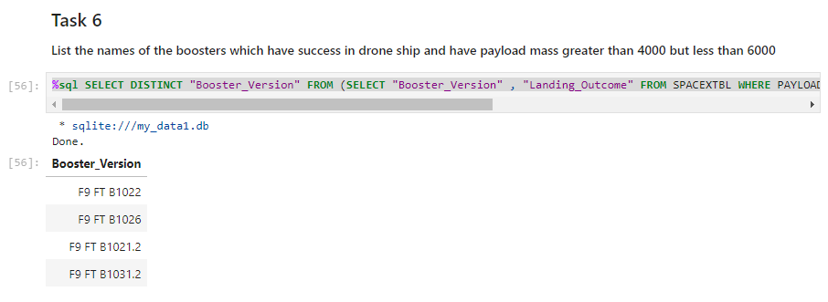
Successful Drone Ship Landing with Payload between 4000 and 6000
Boosters which have successfully landed on drone ship and had payload mass greater than 4000 but less than 6000
SQL query is as below.
%sql SELECT DISTINCT "Booster_Version" FROM (SELECT "Booster_Version" , "Landing_Outcome" FROM SPACEXTBL WHERE PAYLOAD_MASS__KG_ BETWEEN 4000 AND 6000) WHERE "Landing_Outcome" IS "Success (drone ship)"
Booster_Version
F9 FT B1022
F9 FT B1026
F9 FT B1021.2
F9 FT B1031.2

Slide 33
Total Number of Successful and Failure Mission Outcomes
Mission Outcomes are as follows.
Query result is as follows
%sql SELECT COUNT ("Mission_Outcome"),"Mission_Outcome" FROM SPACEXTBL GROUP BY "Mission_Outcome"
1 | Failure (in flight)
98 | Success
1 | Success
1 | Success (payload status unclear)

Slide 34
Boosters Carried Maximum Payload
Following boosters carried the maximum payload of 15600 kg
F9 B5 B1048.4
F9 B5 B1049.4
F9 B5 B1051.3
F9 B5 B1056.4
F9 B5 B1048.5
F9 B5 B1051.4
F9 B5 B1049.5
F9 B5 B1060.2
F9 B5 B1058.3
F9 B5 B1051.6
F9 B5 B1060.3
F9 B5 B1049.7
SQL query is as below.
%sql SELECT DISTINCT "Booster_Version" FROM SPACEXTBL WHERE "PAYLOAD_MASS__KG_" IS ( SELECT MAX("PAYLOAD_MASS__KG_") FROM SPACEXTBL)

Slide 35
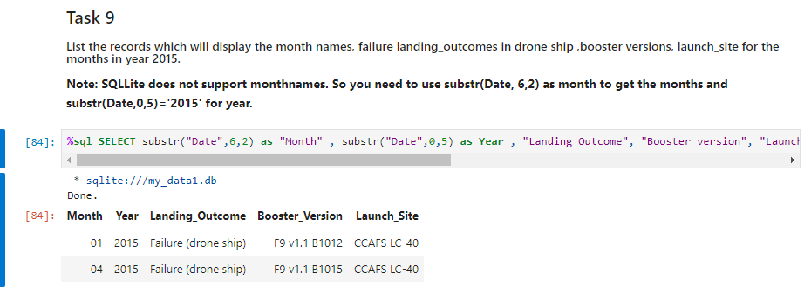
2015 Launch Records
List the failed landing_outcomes in drone ship, their booster versions, and launch site names for in year 2015
SQL Query is as below
%sql SELECT substr("Date",6,2) as "Month" , substr("Date",0,5) as Year , "Landing_Outcome", "Booster_version", "Launch_site" FROM SPACEXTBL WHERE "Landing_Outcome" IS "Failure (drone ship)" AND SUBSTR("Date",0,5) IS "2015"
Month Year Landing_Outcome Booster_Version Launch_Site
01 2015 Failure (drone ship) F9 v1.1 B1012 CCAFS LC-40
04 2015 Failure (drone ship) F9 v1.1 B1015 CCAFS LC-40

Slide 36
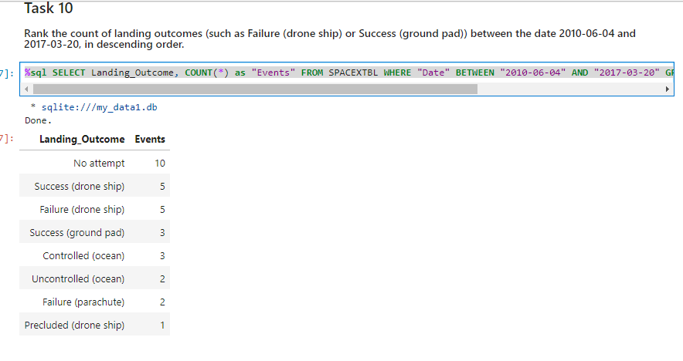
Rank Landing Outcomes Between 2010-06-04 and 2017-03-20
Ranked count of landing outcomes.
SQL query is as below.
%sql SELECT Landing_Outcome, COUNT(*) as "Events" FROM SPACEXTBL WHERE "Date" BETWEEN "2010-06-04" AND "2017-03-20" GROUP BY "Landing_Outcome" ORDER BY "Events" DESC
We are selecting the count of landing outcomes between the given dates by grouping them and ordering them in descending order.

Slide 37

Section 3

Slide 38
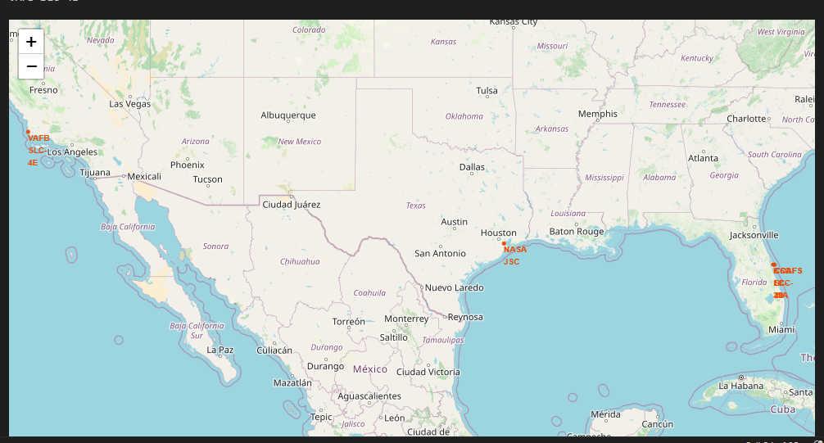
SpaceX Launch Sites
Key considerations selecting a space launch sites are as below, which can be observed from here and other assessments below.
Proximity to the Equator:
Earth's Rotational Velocity provides an initial boost to a rocket launched eastward. This boost is maximized closer to the equator, where the Earth's rotational speed is highest. And there is also Orbital Inclination which Launching closer to the equator allows for easier access to a wider range of orbital inclinations, including geostationary orbits.
2. Downrange Safety:
Special considerations such as using unpopulated areas where Launch sites are typically located in remote areas with minimal population density to minimize the risk of casualties in case of launch failures. Further Many launch sites are situated near large bodies of water to ensure that falling debris lands in a safe, unpopulated area.
3. Infrastructure and Accessibility:
Transportation: Good transportation links are essential for transporting rocket components, fuel, and personnel to the launch site.
Support Facilities: Adequate infrastructure, including power, water, and communication systems, is necessary for the operation of the launch site.

Slide 39
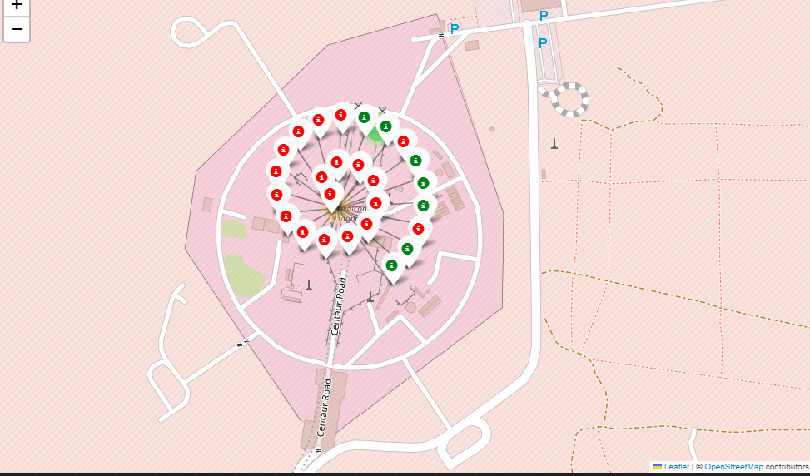
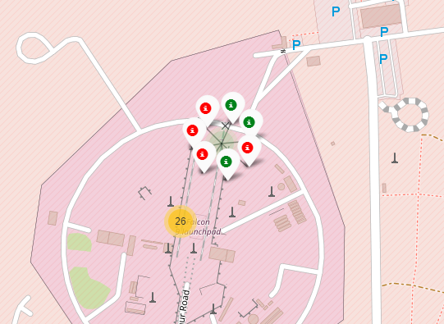
Launch Outcomes
Only 7/26 ( 27%) of the launches made from CCAFS LC -40 were sucessfull
Only 3/7 (43%) of the launches were successful form CCAFS SLC-40
Green for Successful Launches
Red for Unsuccessful launches

Slide 40
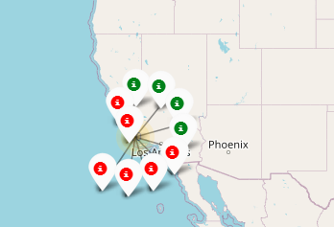
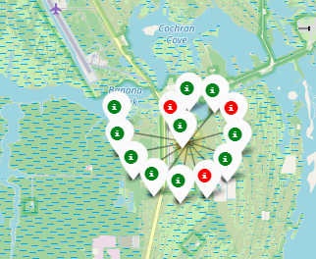
Launch Outcomes
Only 4/10 (40%) of the launches made from VFAB SLC-4E were successful.
However
10/13 ( 77%) of the launches made from KSC-LC 39A were successful
Green for Successful Launches
Red for Unsuccessful launches

Slide 41
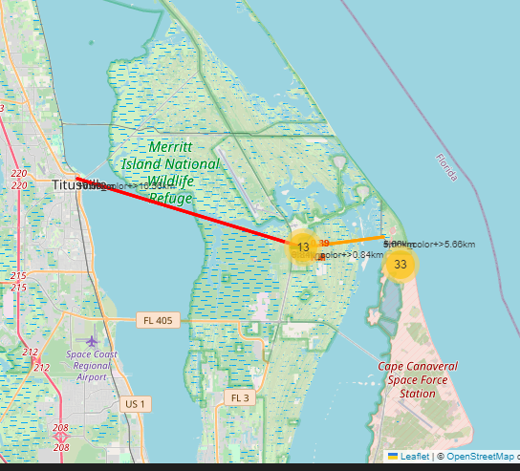
Distance to Proximities from site VFAB SLC-4E
VFAB SLC-4E site is 0.89 km from the sea
And it is 16.5 km from the nearest city Titusville
Close to main transportation locations such as 5.6 km from the railway and .84 km form the highway

Slide 42

Section 4

Slide 43
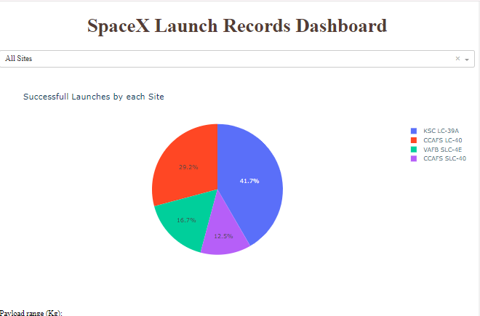
All Site Launch Success
KSC LC-39A has the highest number of successful launches.

Slide 44
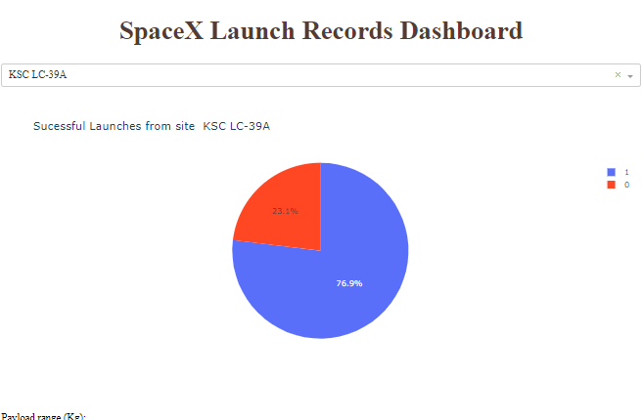
KSC LC-39A Site Success Rate
There are 10(77%) Successfully launches from KSC LC-39A site

Slide 45
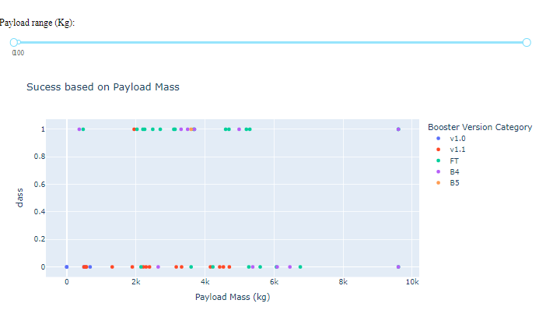
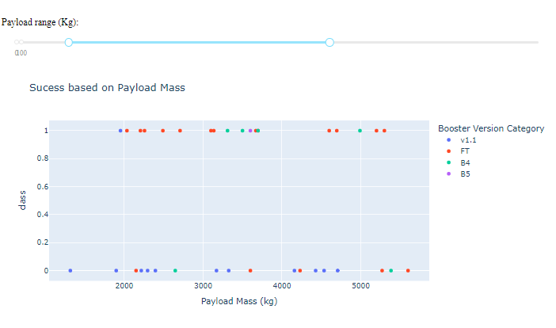
Impact on Payload Mass to Launch Success
There seems to be limited success to launches beyond 6000 kg
Also not much of a success for payloads lower than 2000 kg
Hence data indicate the optimum payload range to be between 2000 and 6000

Slide 46

Section 5

Slide 47
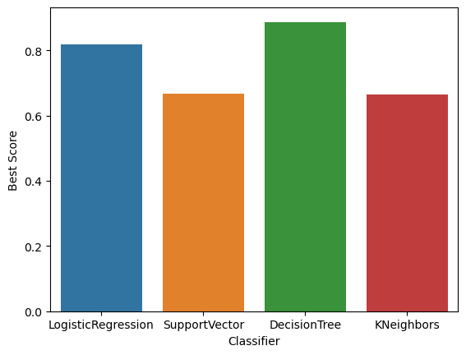
Classification Accuracy
Based on the accuracy factor, Decision Tree Classifier has the highest accuracy followed by Logistic Regression

Slide 48
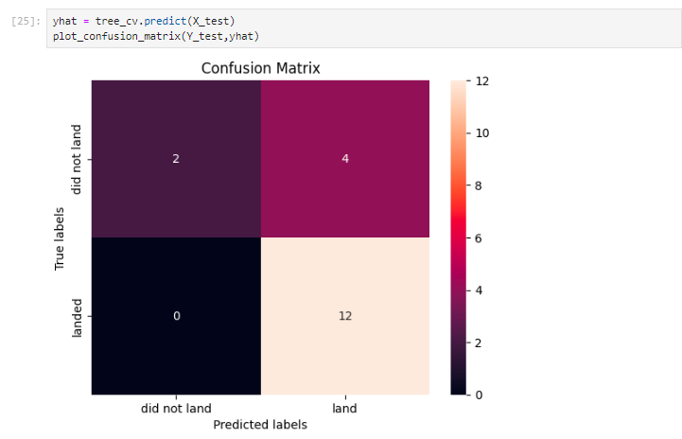
Confusion Matrix of Decision Tree Classifier
A confusion matrix summarizes the performance of a classification algorithm
The fact that there are false positives (Type 1 error) is not a good indicator, which reduces the precision and F1 score
Confusion Matrix Outputs are as below for the decision tree classifire:
12 True positive
2 True negative
4 False positive
0 False Negative
Precision= TP / (TP + FP) = 12 / 16 = .75
Recall= TP / (TP + FN)12 / 12 = 1
F1 Score= 2 * (Precision * Recall) / (Precision + Recall)
=2 * (.75 * 1) / (.75 + 1) = 1,5/ 1.75 = 0.857
Accuracy= (TP + TN) / (TP + TN + FP + FN) = 14/18
= 0.77

Slide 49
Conclusions
Success of missions has increase with time
We can observe a 100% success rate for ES-L1, GEO , HEO and SSO orbit types
There were serval drone ship landings
Highest performing payload mass is between 2,000 and 6,000 kg
Space X has chosen sites near the equator. Other factors such as close to a main road and railway was also import
Being close to a coast makes some room for failed landings
Most successful site is KSC LC-39A with a success rate of 77%
Decision Tree Classifier has the best learning algorithm for the data available

Slide 50


